Slide 1
Your brain and nervous system
How does it work?

Slide 2
your nervous system
is divided into the central nervous system (CNS)
which is the brain and spinal cord
Medical Art Service, Munich /, Wellcome Images
and the
peripheral nervous system (PNS)
Credit Medical Art Service, Munich /, Wellcome Images
which connects everything to the brain and spinal cord
N0022597
N0022610

Slide 3
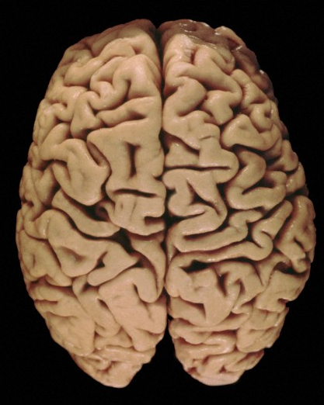
your brain
interprets the information it gets though your senses in order to monitor and regulate your body
as well as being responsible for
thinking, learning, memory and emotion
Different parts of your brain have different functions…
Credit: Heidi Cartwright, Wellcome Images
B0005749

Slide 4
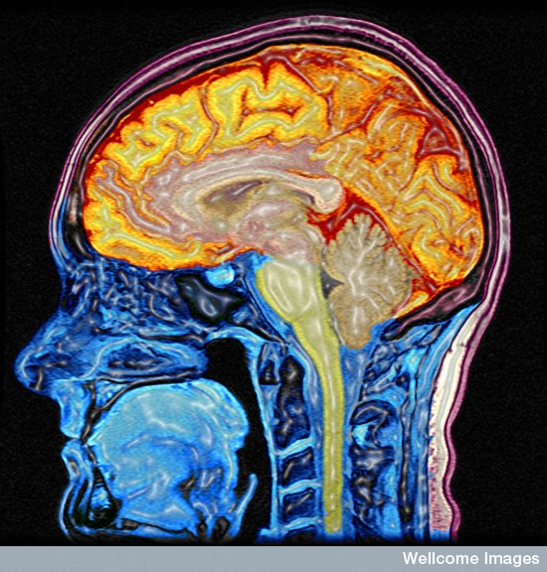
different regions have different functions
Cerebral cortex
Functions include: planning; reasoning; language; recognising sounds and images; memory.
Corpus callosum
connects the brain’s right and left hemispheres
Brain stem
regulates heart rate, breathing, sleep cycles
and emotions
Cerebellum
important for coordination, precision and timing of movement
Credit: Mark Lythgoe & Chloe Hutton, Wellcome Images

Slide 5
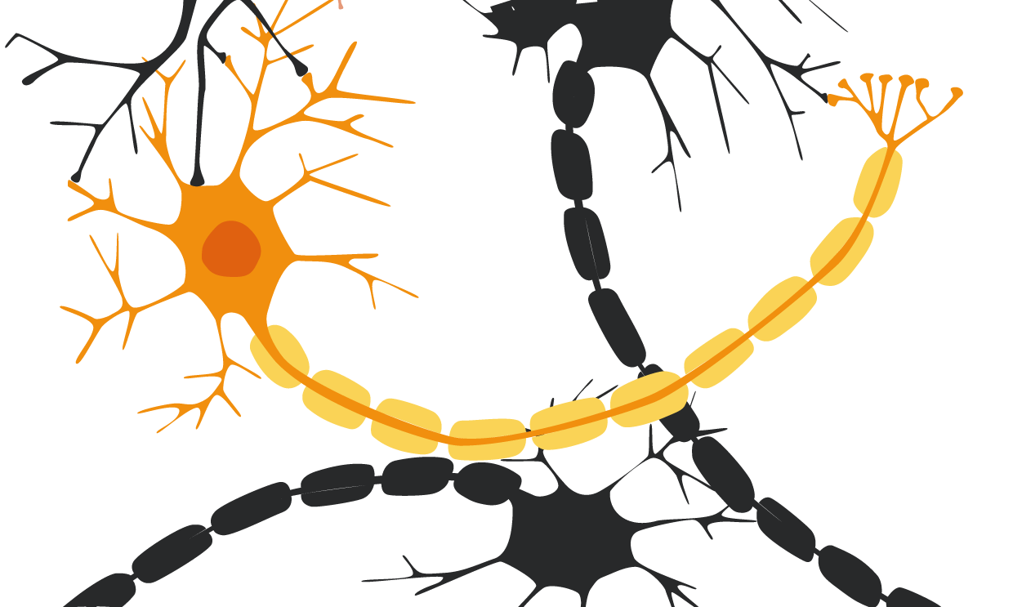
the cells of the nervous system are called neurons
dendrites
nerve endings
myelin sheath
cell body
nucleus
axon
structure of a neuron

Slide 6
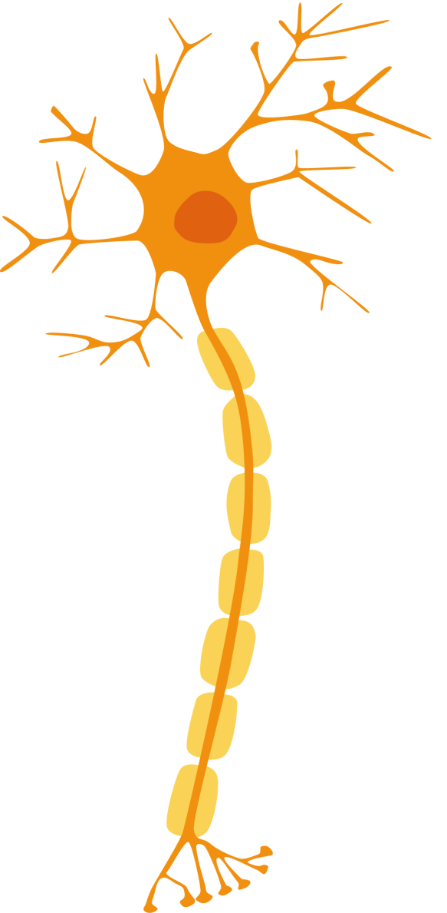
there are different types of neuron
sense organ
dendrites
direction of electrical signal
cell body
myelin sheath
axon
muscle
nerve endings
motor neuron
sensory neuron
relay neuron
sends signals to your muscles to tell them to move
sends signals from your sense organs
connects neurons to other neurones

Slide 7
neurones communicate with each other using a mixture of electrical & chemical signals
dendrites
nerve endings
But what happens when the signal reaches the end of the axon?
myelin sheath
cell body
nucleus
an electrical signal is transmitted along the axon
axon

Slide 8
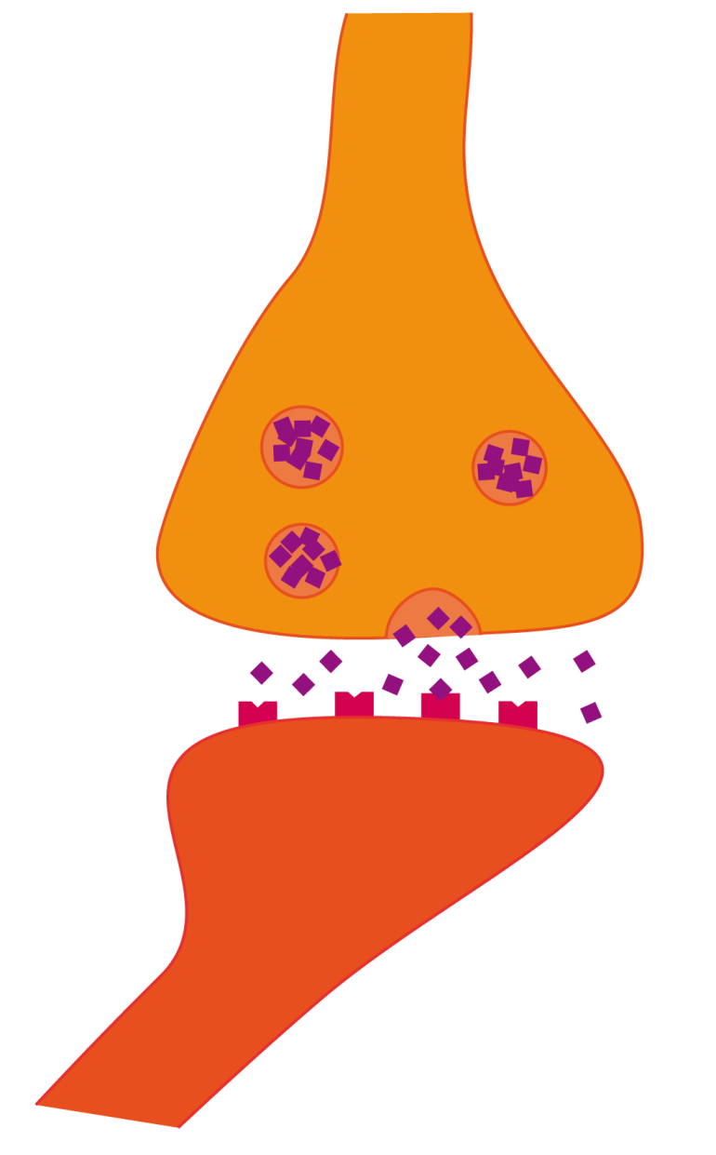
signals cross between neurons at the synapse
synapse
dendrites
nerve endings
vesicle
myelin sheath
synaptic cleft
cell body
nucleus
receptor
the signal
is transmitted to another neurone across a junction called a synapse by chemicals called neurotransmitters.
neurotransmitter
axon

Slide 9
signals cross between neurons at the synapse
1
electrical impulse triggers vesicles to move to the synapse membrane
vesicles fuse with the membrane and release neurotransmitter into the synaptic cleft
synapse
2
dendrites
nerve endings
3
neurotransmitter diffuses across the cleft and binds to receptors on the other side
vesicle
myelin sheath
synaptic cleft
cell body
nucleus
receptor
the signal
is transmitted to another neurone across a junction called a synapse by chemicals called neurotransmitters.
neurotransmitter
4
Once enough receptors have neurotransmitters bound to them, the signal is transmitted…
axon

Slide 10
The point where your muscles and nervous system meet is called the neuromuscular junction (NMJ)
Signals sent from your central nervous system to the NMJ tell muscles to move
The synapses at the NMJ use a neurotransmitter called acetylcholine
muscle

Slide 11
Your brain changes and adapts
What happens as our brains mature?

Slide 12
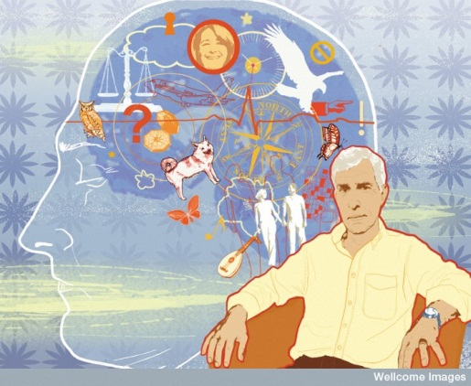
your brain changes and adapts all the time and all through your life
your brain learns and forms memories by strengthening synapses that are used a lot and weakening those that are used less often
Credit Marina Caruso, Wellcome Images

Slide 13
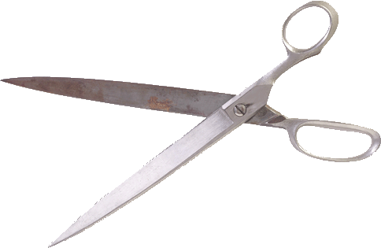
What happens as you grow?
Between birth and age 3 your brain makes lots of new synapses
A toddler has 2-3 times more synapses than an adult
As your brain matures, it prunes synapses to make it more efficient
During adolescence your brain has a major tidy-up and gets rid of lots of connections it isn’t using
This is a critical and delicate process. It is thought that conditions such as schizophrenia could be the result of it going wrong
Some evidence suggests that using drugs can disrupt this process

