Slide 1
Chapter 14: Bones, Muscles, and Skin Section 4: The Skin
p. 488 - 493

Slide 2
What are the functions and the structures of the skin?
The skin forms a barrier against disease-causing microorganisms and harmful substances, and prevents the loss of important fluids.
The skin helps the body maintain a steady temperature;
The skin helps to eliminate wastes through perspiration
The skin contains nerves that gather information about the environment
The skin cells produce vitamin D that helps your body absorb calcium

Slide 3
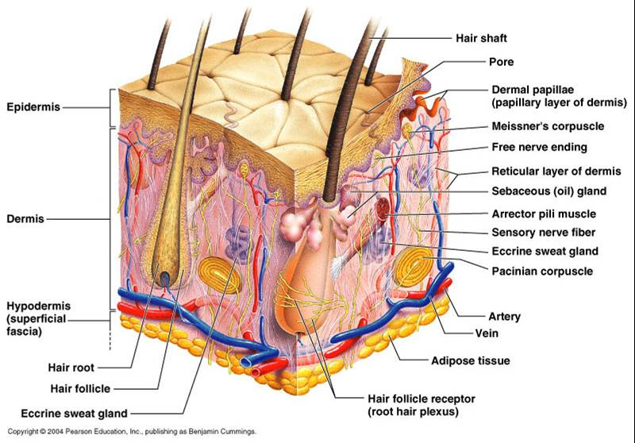

Slide 4
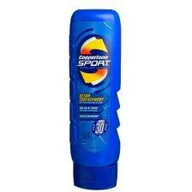
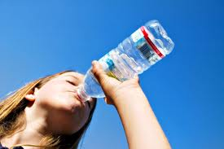
What habits can help keep your skin healthy?
Eat a healthful diet which includes drinking plenty of water.
Keep your skin clean and dry
Limit your exposure to the sun

Slide 5
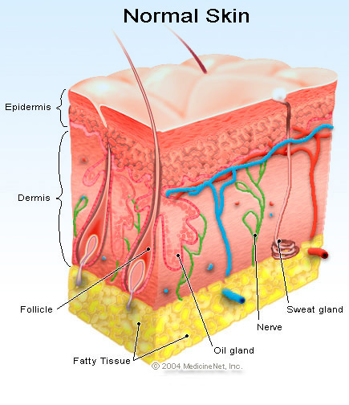
Epidermis
The skin is organized into two main layers, the epidermis and the dermis
The epidermis is the outer layer of the skin. It is thinner than the dermis and does not have nerves or blood vessels
Most of the protection provided by the skin is due to the layer of dead cells on the surface.

Slide 6
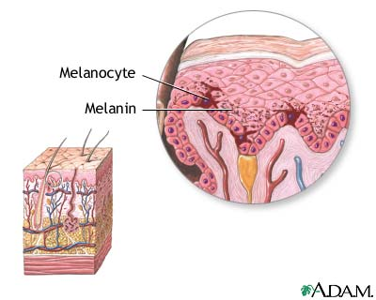
Melanin
A pigment, or colored substance, that gives skin its color. The more melanin in the epidermis, the darker your skin is.
Melanin production helps to protect the skin from burning.

Slide 7
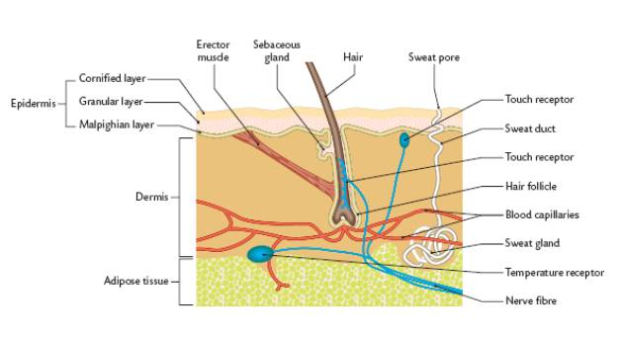
Dermis
The inner layer of the skin.
It contains nerves and blood vessels.
It contains sweat glands, hairs and oil glands.

Slide 8
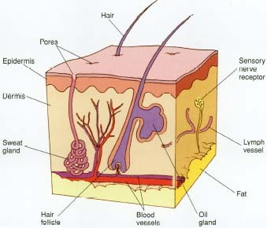
Pores
Openings in the dermis through which perspiration reaches the surface of the skin.

Slide 9
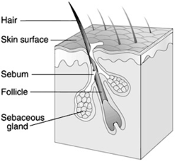
Follicle
The structure in the dermis of the skin from which a strand of hair grows.

Slide 10
Cancer
A disease in which some cells in the body divide uncontrollably.

