Slide 1
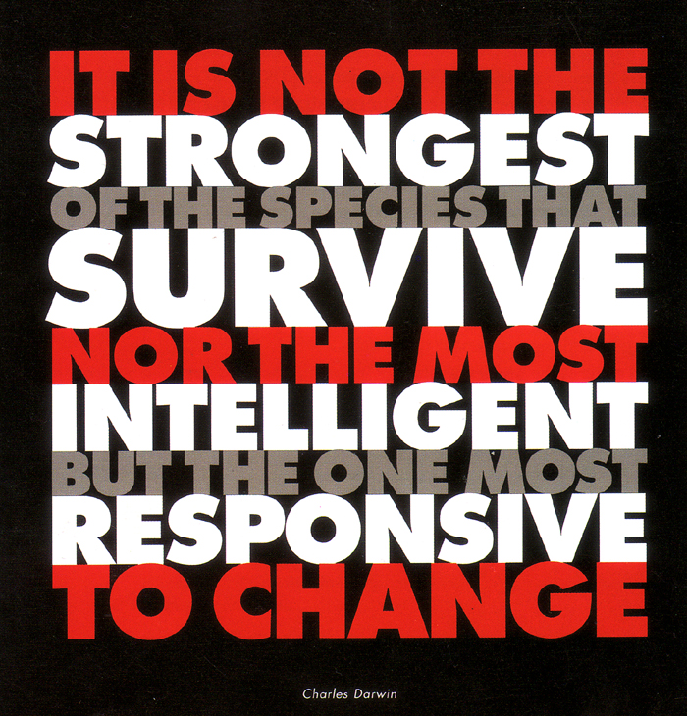

Slide 2
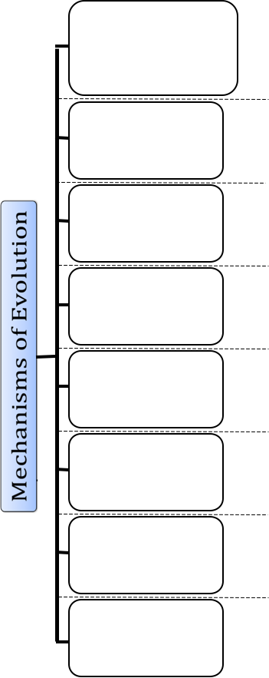

Slide 3
Natural Selection
Mutations
Recombination
Gene Flow
Genetic Drift
Artificial Selection
Non-Random Mating
Reproductive Isolation

Slide 4
Exploring Darwin & His Ideas
Think about the following questions:
What explains the explosion of living creatures on Earth—1.4 million different species discovered so far?
To what prediction did the finches collected on the Galapagos lead Darwin?
What did Darwin predict causes one species to turn into another?

Slide 5
Video of Darwin
http://www.wfisd.net/Page/13303

Slide 6
Natural Selection
The unequal survival and reproduction of organisms due to environmental forces, resulting in the preservation of favorable adaptations. (The best adaptations for survival and reproduction are passed on.)

Slide 7
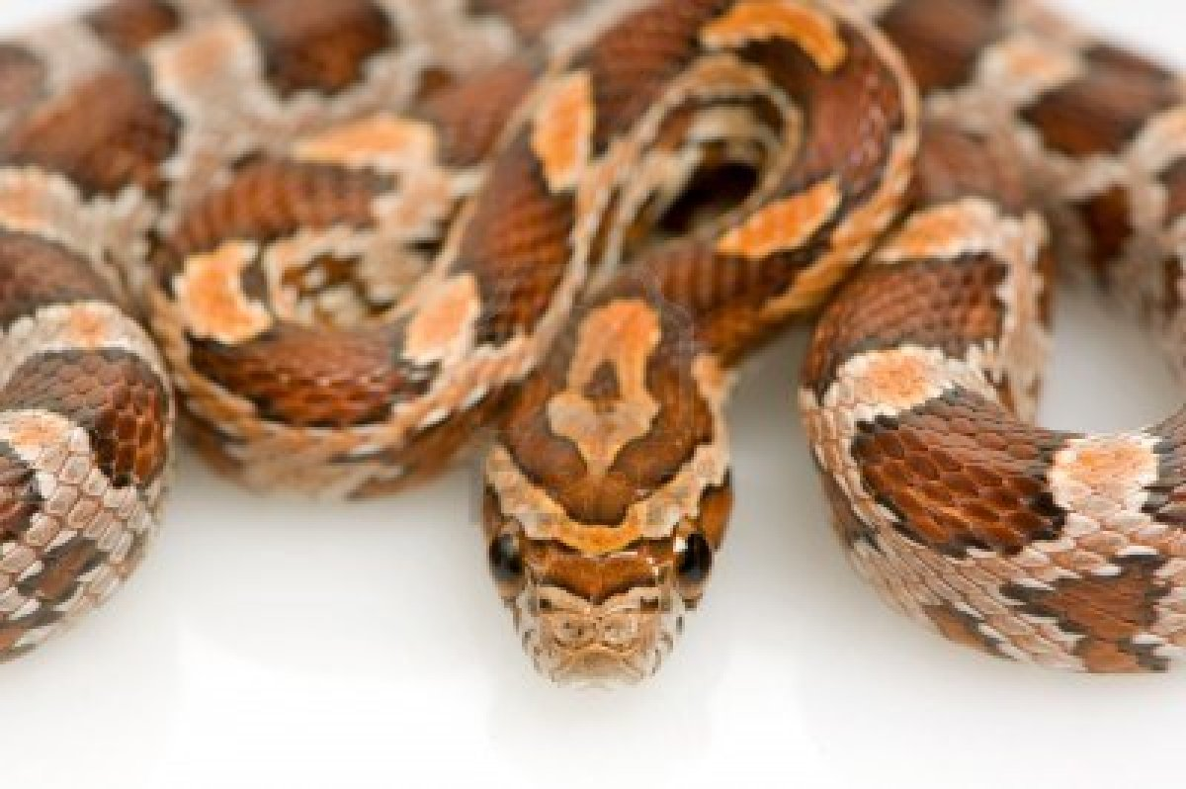
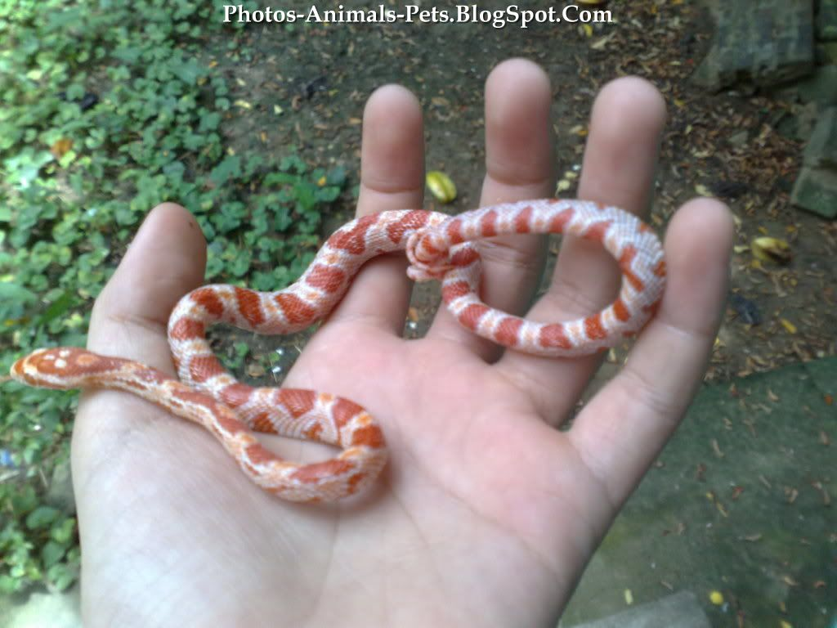
Natural Selection:
It is the production of variations due to:
Mutations: Changes in the DNA
Meiosis: crossing over during Prophase I
Random mate selection & fertilization
Do we see variation within different wild species ?

Slide 8
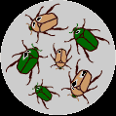
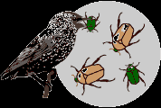
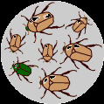
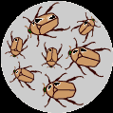
Differential reproductive success
imagine a population of beetles:
There is variation in traits. For example, some beetles are green and some are brown.
There is differential reproduction. Since the environment can't support unlimited population growth, not all individuals get to reproduce to their full potential. In this example, green beetles tend to get eaten by birds and survive to reproduce less often than brown beetles do.
There is heredity. The surviving brown beetles have brown baby beetles because this trait has a genetic basis.
End result: The more advantageous trait, brown coloration, which allows the beetle to have more offspring, becomes more common in the population. If this process continues, eventually, all individuals in the population will be brown.

Slide 9
Differential reproductive success
There are a few items that influence DRS:
Competition
Limited resources
Producing more offspring than can survive
Environmental factors
Fitness (survivability of a specific genotype/trait)
Genetic Variation (differences in the DNA)
Now complete this concept map

Slide 10
Differential
Reproductive
Success
Notes:
Instruct students to draw this concept map in their science notebooks. Explain that the map is designed to help them understand the components of differential reproductive success and how it relates to natural selection.

Slide 11
A
B
C
E
F
D
Differential
Reproductive
Success
Natural Selection
Notes:
Discuss the concept map before filling in the information. This will help students organize their thinking.
Ask:
According to the concept map, which letter represent the components needed from differential reproductive success (DRS) to occur? (D,E,F)
According to the concept map, what does DRS lead to? (G)
According to what was learned in the candy activity, what do you think letter D is? (Students may say variation, but guide them in this direction if they are unable to come up with that answer.)

Slide 12
Limited
Resources
Organisms produce more offspring than can survive.
Environmental Factors
Fitness
Competition
Genetic
Variation
Differential
Reproductive
Success
Natural Selection
Notes:
Make sure students know the definitions to the following terms: genetic variation, fitness, competition, resources, and environmental factors.
Take time to explain how the various components lead to DRS.

Slide 13
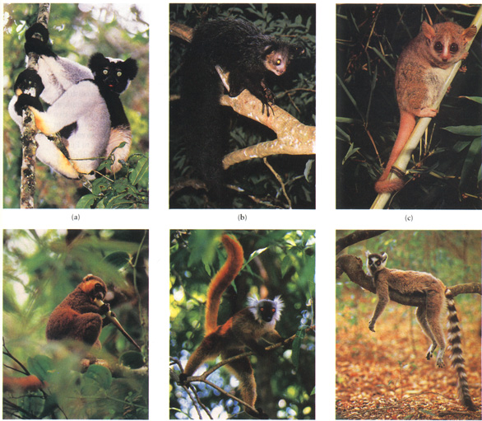
Lemurs of Madagascar

Slide 14
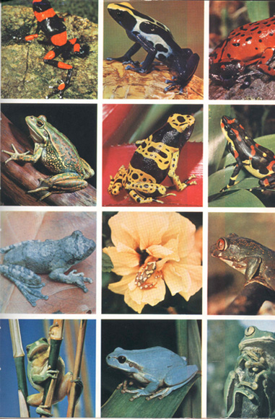
Amazonian Frogs

Slide 15
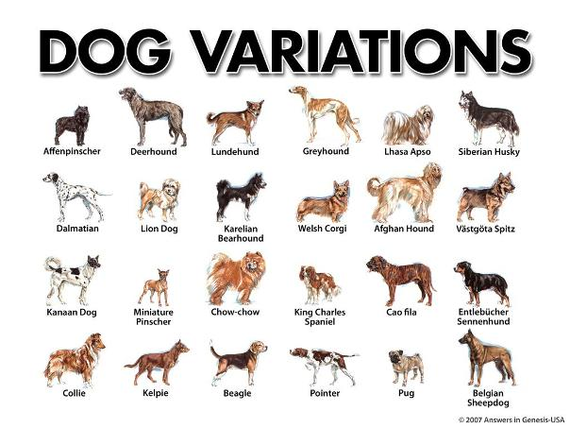
Humans select traits for dogs, pigeons and other animals when they breed them (we call this ARTIFICIAL SELECTION).
Bred dogs came from a single original species
Who selects the traits for wild plans & animals?

Slide 16
NOBODY!!
There is no agent involved in natural selection.
Natural selection is a process of elimination
INDIVIDUALS THAT HAVE TRAITS THAT ARE BEST ADAPTED FOR THE CURRENT ENVIRONMENT ARE THE ONES THAT SURVIVE TO BREED AND PASS ON THEIR GENES TO THE NEXT GENERATION.
Organisms not possessing the beneficial traits either die or don’t have as many offspring.
Natural Selection is Survival of the fittest

Slide 17
Natural Selection is Survival of the fittest
This does not mean that the biggest gets to live. (Think David and Goliath)
“He who has the BEST trait/adaptation to survive has the best chance of doing so.”
Using Germ-X kills 99% of the bacteria, it’s the 1% that continues to live on. They possess a gene that makes them resilient to Germ-X and that gene is therefore passes on to the next generation.
Natural Selection is a mixture of both Chance and necessity

Slide 18
Main Types of Selection Pressures
Directional Selection
Natural selection favors one extreme of the population for that trait
often happens when environment changes in a consistent way- e.g.climate gets colder.
Disruptive Selection
Natural selection favors both extremes selected
Causes species to diverge
Stabilizing Selection
Natural selection favors the average for population selected

Slide 19
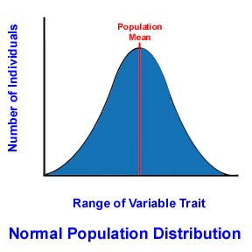
Original Population

Slide 20
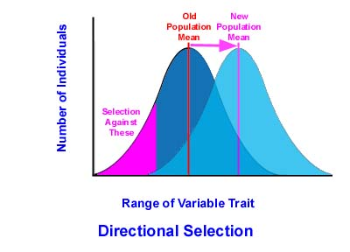
Directional Selection
Neck of Giraffe
Antibiotic resistance of bacteria
Moth color (melanin)
Camouflage/Mimicry

Slide 21
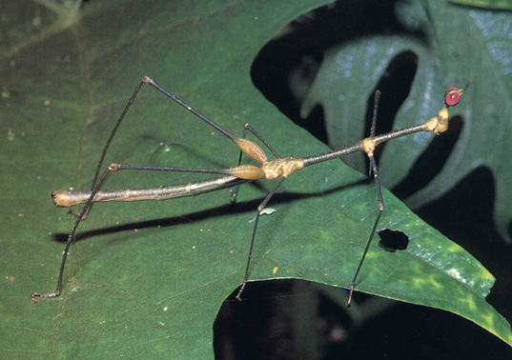
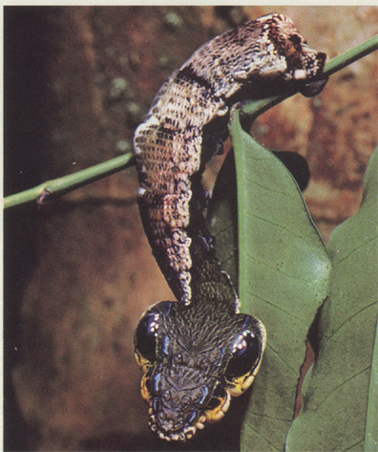
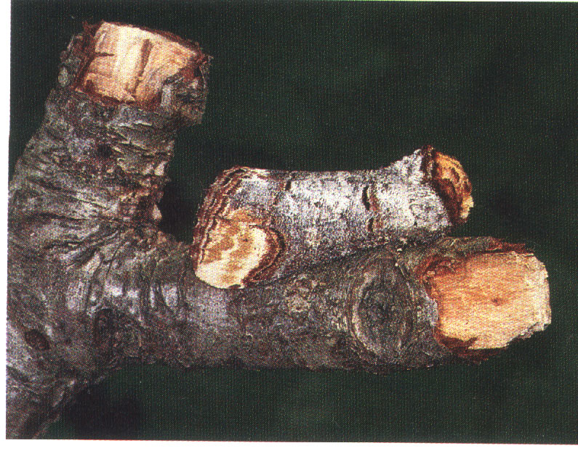
Directional Selection: Mimicry (mimic environment)

Slide 22
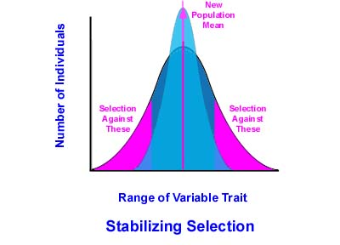
Stabilizing Selection
When the extremes of the trait aren’t as well suited
Examples
bird clutch size
Human birth weight
Human height

Slide 23
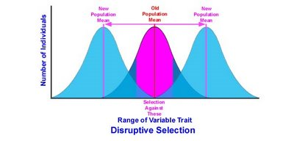
Disruptive Selection
Causes divergence within the species
Occurs when two different types of resources in one area
Results in specialization for each branched group
May lead to formation of new species
E.g. Darwin’s Finches

Slide 25
What acts as a selection pressure on a population?
Competition for food
Competition for a mate
Changes in the environment
Predators
Parasites
Example of Natural Selection in Action: Monarch / milkweed
Card game
Video of Darwin’s Finches

Slide 26
Examples of selection pressures...
Predators - variants with adaptations allowing them to escape predators have more offspring
- e.g. speed, defensive weapons, camouflage, mimicry
Prey/Food - variants with adaptations allowing them to obtain food have more offspring
- e.g. Speed, senses for finding prey/food, weapons for killing prey or obtaining food, camouflage for stealth
Climate - those who can survive new climate best have more kids
- e.g. ice age, change in climate due to migration.
Mates - variants with adaptations allowing them to attract a mate to have offspring
- e.g. strong, attractive, good provider

Slide 27
Types of Natural Selection
Type | Definition | Result
Directional Selection
Disruptive Selection
Stabilizing Selection
Notes:
Make sure students understand that sometimes natural selection, particularly stabilizing selection, maintains status quo rather than causing major trait changes in a population.

Slide 28
Types of Natural Selection
Type | Definition | Result
Directional Selection | A process of natural selection in which a single phenotype at one extreme of the phenotypic range is favored | The population's trait distribution shifts toward an extreme.
Disruptive Selection
Stabilizing Selection
Notes:
Make sure students understand that sometimes natural selection, particularly stabilizing selection, maintains status quo rather than causing major trait changes in a population.

Slide 29
Types of Natural Selection
Type | Definition | Result
Directional Selection | A process of natural selection in which a single phenotype at one extreme of the phenotypic range is favored | The population's trait distribution shifts toward an extreme.
Disruptive Selection | A process of natural selection that favors individuals at both extremes of a phenotypic range | Can cause such differences among a species that the variation leads to new species (SPECIATION)
Stabilizing Selection
Notes:
Make sure students understand that sometimes natural selection, particularly stabilizing selection, maintains status quo rather than causing major trait changes in a population.

Slide 30
Types of Natural Selection
Type | Definition | Result
Directional Selection | A process of natural selection in which a single phenotype at one extreme of the phenotypic range is favored | The population's trait distribution shifts toward an extreme.
Disruptive Selection | A process of natural selection that favors individuals at both extremes of a phenotypic range | Can cause such differences among a species that the variation leads to new species (SPECIATION)
Stabilizing Selection | A process of natural selection that tends to favor genotypic combinations that produce an intermediate phenotype | It reduces phenotypic variation. Natural selection tends to remove the more severe phenotypes. MAINTAINS STATUS QUO
Notes:
Make sure students understand that sometimes natural selection, particularly stabilizing selection, maintains status quo rather than causing major trait changes in a population.

Slide 31
Mechanisms of Evolution Models
Look back at your graphic organizer. We will be exploring the following processes and their influence on population change (evolution):
Natural Selection
Mutations
Gene flow
Genetic drift
Artificial selection
Non-random mating
There are too many limits to this model to explore recombination and reproductive isolation. Those will be explained after the models.

Slide 32
Mechanisms of Evolution Models
The circles on your boards help distinguish the original population makeup from what it might look like after the change and its makeup many, many generations later.
The dots represent individual organisms within the population.
Original Population

Slide 33
Mechanisms of Evolution Models
Instead of thinking about the dots as representing a single individual, think about them representing a percentages of individuals.
For example, in the population shown below, about half of the individuals are red, a quarter are blue, and a quarter are green. That means that if 1,000 individuals made up that population, about 500 would be red, about 250 blue, and 250 green.
Original Population
When predicting outcomes, use estimations. Don’t get stumped thinking about exactly how many dots are in a population!!

Slide 34
Mechanisms of Evolution: Natural Selection
Original Population
Notes:
We will start with natural selection. Students should already be familiar with natural selection so this one should help them understand how the model works without having to understand new concepts.
Each group should set up the Original Population as they see it here.
Have them read the scenario and predict and set up what the population would look like after the chemical spill using their dots.

Slide 35
Mechanisms of Evolution: Natural Selection
After Chemical Spill
Notes:
Give students time to predict and show how the population would look after many generations.

Slide 36
Mechanisms of Evolution: Natural Selection
Many Generations Later
Notes:
Make sure students compare the original population to the population many generations later. This will help them see how the population changed as a result of natural selection.

Slide 37
Mechanism of Evolution: Mutations
Original Population

Slide 38
Mechanism of Evolution: Mutations
After Mutation

Slide 39
Mechanism of Evolution: Mutations
Many Generations Later
Notes:
Make sure students compare the original population to the population many generations later. This will help them see how the population changed as a result of the mutation.

Slide 40
Mechanisms of Evolution: Mutations
Real-World Examples:
http://evolution.berkeley.edu/evosite/evo101/IIIC2aCasestudy.shtml

Slide 41
Mechanism of Evolution: Gene Flow
Neighboring
Population
Original Population

Slide 42
Mechanism of Evolution: Gene Flow
After Migration

Slide 43
Mechanism of Evolution: Gene Flow
Many Generations Later
Notes:
Make sure students compare the original population to the population many generations later. This will help them see how the population changed as a result of migration/gene flow.

Slide 44
Mechanisms of Evolution: Gene Flow
Real-World Examples:
http://evolution.berkeley.edu/evosite/evo101/IIIC4aGeneflowdetails.shtml

Slide 45
Mechanisms of Evolution: Genetic Drift
Original Population

Slide 46
Mechanisms of Evolution: Genetic Drift
After Lightning

Slide 47
Mechanisms of Evolution: Genetic Drift
Many Generations Later
Notes:
Make sure students compare the original population of the population many generations later. This will help them see how the population changed as a result of genetic drift.
Discuss that genetic drift tends to happen in populations that are small, where random events could have significant impacts on the genetic makeup of the population. At this point, make sure you explain the bottleneck and founder’s effect.
http://www.bio.georgiasouthern.edu/bio-home/harvey/lect/lectures.html?flnm=nsln&ttl=Population%20change%20and%20natural%20selection&ccode=el&mda=scrn

Slide 48
Mechanisms of Evolution: Genetic Drift
Real-World Examples:
http://www.bio.georgiasouthern.edu/bio-home/harvey/lect/lectures.html?flnm=nsln&ttl=Population%20change%20and%20natural%20selection&ccode=el&mda=scrn
http://highered.mcgraw-hill.com/sites/dl/free/0072835125/126997/animation45.html

Slide 49
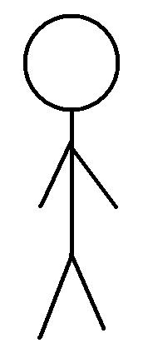
Mechanisms of Evolution: Artificial Selection
Original Population

Slide 50
Mechanisms of Evolution: Artificial Selection
Many Generations Later

Slide 51
Mechanisms of Evolution: Artificial Selection
Real-World Examples:
http://learn.genetics.utah.edu/content/variation/artificial/

Slide 52
Mechanisms of Evolution: Non-Random Mating
Original Population
Blue = BB or Bb
Red = bb
x
Notes:
Students may need to think about Punnett squares probability of offspring. It maybe helpful to do a cross between two heterozygotes and also two red individuals. This will show students that not only are red individuals all red offspring but blue individuals are also producing red offspring as well. Because of this and non-random mating, the frequency of red alleles will increase many generations later.

Slide 53
Mechanisms of Evolution: Non-Random Mating
Many Generations Later

Slide 54
Mechanisms of Evolution: Non-Random Mating
Real-World Examples:
http://www.bio.georgiasouthern.edu/bio-home/harvey/lect/lectures.html?flnm=nsln&ttl=Population%20change%20and%20natural%20selection&ccode=el&mda=scrn

Slide 55
Mechanisms of Evolution: Reproductive Isolation
A new species may form when one population of a species becomes reproductively isolated from another population of the same species.
Over time, evolutionary mechanisms occur that alter the gene pool of the isolated population so that it is no longer reproductively compatible with the original population.
Notes:
Resource with examples: http://evolution.berkeley.edu/evolibrary/article/evo_40

Slide 56
What is a Species?
A group of individuals that actually or potentially interbreed in nature. A species is the biggest gene pool possible under natural conditions.
Scientists group organisms according to their similarities.
The most similar organisms belong to a species.
Members of the same species can mate and produce fertile offspring.
Ex: Humans belong to the species Homo sapiens.

Slide 57
How Do New Species Evolve?
Speciation is a lineage-splitting event that produces two or more separate species.
Since being a member of one species is defined by the ability to successfully reproduce, speciation (the formation of a different species) must involve an inability to successfully reproduce.

Slide 58
Reproductive Isolation
Two way reproductive isolation occur:
Prezygotic mechanisms
Postzygotic mechanisms

Slide 59
Prezygotic Mechanisms
Temporal Isolation: Species reproduce in different seasons or at different times of the day.
Geographical Isolation: Physical barriers (e.g., rivers, oceans, mountains) prevent the mixing of populations.
Behavioral Isolation: Species differ in their mating rituals (e.g., differing bird songs, mating colors, dances, pheromones).
Mechanical Isolation: Body structure prevents mating.

Slide 60
Postzygotic Mechanisms
Hybrid inviability: Embryological Arrest: Hybrid embryos often do not develop properly; no viable offspring is created.
Hybrid Sterility: Infertility: Hybrid offspring might grow to viable adults, but these are infertile and cannot produce further offspring
This shuffling, along with sexual reproduction, leads to variation within populations. This variation leads to selection, which ultimately leads to evolution.
(Donkey + Horse = Mule; Mule is sterile.)

Slide 61
Cladogenesis
Cladogenesis is the splitting of one species into two.
How does this happen?
Geographical (physical) isolation, which leads to reproductive isolation. This is also known as allopatric speciation.

Slide 62
How Evolution Occurs
There are two scientific theories regarding how evolution occurs.
Punctuated Equilibrium: This theory proposes that throughout geological time, biological species go through long periods of little change and then have brief periods of rapid change.
Gradualism: This theory proposes that throughout geological time, biological species gradually undergo changes that leads to speciation.
Notes:
This will be explored more in the next lesson.

